Slide 1
Draft e-Commerce Policy Framework of Pakistan
Presentation by
Ministry of Commerce & Textile
Commerce Division

Slide 2
Definition of e-Commerce
For the purpose of e-Commerce Policy Framework;
e-Commerce is defined as buying and selling of goods or services including digital products, through electronic transactions conducted via the internet or other computer-mediated (online communication) networks.

Slide 3
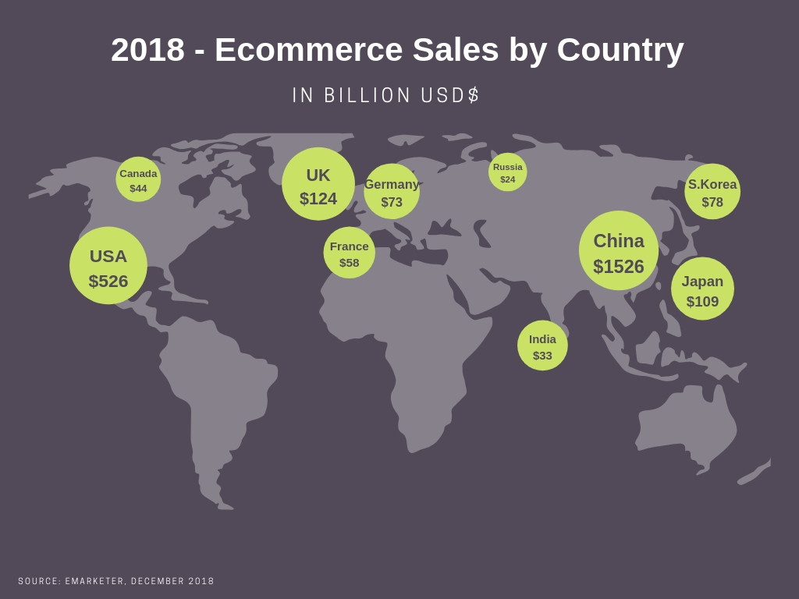

Slide 4
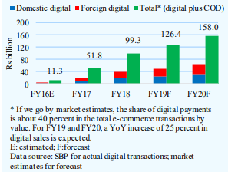
e-Commerce in Pakistan*
e-Commerce sales in 2017 = Rs. 20.7 billion
Grew by 93.7% in 2018 = Rs. 40.1 billion
60% e-Commerce transactions by value are post-paid cash-on-delivery (CoD) transactions

Slide 5
Objectives of e-Commerce Policy Framework
Key driver of Pakistan’s economy
Single window hub and National e-Commerce Council for review and implementation of Policy
Facilitation through regulatory framework
Enhancing exports through e-Commerce platforms
Youth empowerment and employment opportunities through digital connectivity
Efficient payment infrastructure
Streamlining legal systems, taxation structures and digital infrastructure
e-Commerce ecosystem, responsive to consumers’ interests, including dispute resolution
Transparency and accountability in digital industry
Implementation of Sustainable Development Goal-8 (Growth & Decent Work), Goal-9 (Infrastructure and Innovation) and Goal-12 (Sustainable Consumption and Production)

Slide 6
Evolution of e-Commerce Policy Framework
Public and private sector was consulted through Policy Unit and Advisory Council
50 consultative sessions held
300 stakeholders consulted
5 working group reports from public and private sector
Draft publicized on Commerce Division website

Slide 7
e-Commerce Policy Framework Key Areas
Financial Inclusion & Digitization
SME & Youth
ICT & Telecom
Facilitation & Regulation
Logistics
Taxation
Global Connectivity
Data Protection and Investment
Consumer Protection

Slide 8
e-Commerce regulation and facilitation
I - Key Features:
a. Facilitation
Establishment of National e-Commerce Council
Re-export of faulty goods
Implementation of National Single Window
Review and following of International best practices in taxation
Allocation of the subject of e-Commerce to the Commerce Division
Introduction of e-Procurement model

Slide 9
e-Commerce regulation and facilitation
b. Regulation
Compulsory registration with SECP of all e-businesses, having sales of more than 1 million PKR per annum
All online businesses to maintain a physical address in Pakistan
Code of Conduct introduced for e-Commerce platforms to ensure consumer protection

Slide 10
Financial inclusion and digitization through payment infrastructure development
II - Key Features:
a. Facilitation
Guidelines for merchants’ digital on boarding ,by SBP
Access to international payment gateways
b. Regulation
Mechanism introduced for gradual shifting on digital payments
c. Promotion
Regulation of free lancers by MoC (Pak at 4th no in the world in free lancing services)
Retention of export earnings in foreign currency accounts

Slide 11
Empowering Youth and SMEs through Business Support Programs and Trade Development
III - Key Features:
a. Facilitation
Association of Freelances, being registered with MoC
Creation of an e-Commerce business facilitation hub, by TDAP
Exports enhancing e-Commerce trainings & talent development programs for SMEs
Digital marketing for SMEs
Synergies with other Government initiatives, like Kamyab Jawan program
b. Promotion
Initiation of Pak e-SME program
E-Commerce aggregator
Access to finance for SMEs through venture capital and seed funding

Slide 12
Consumer Protection
IV - Key Features:
a. Regulation
Amendments in existing Federal & Provincial Consumer Protection Laws to address e-disputes as well
Mandatory setting up of customer support system and dispute resolution mechanism by all e-commerce platforms
Establishment of Consumer Courts in all districts of each province
b. Facilitation
Establishment of Independent Alternate dispute resolution mechanism at Federal & Provincial level
Inclusion of e-commerce disputes in draft Trade Dispute Resolution Act (TDRA)
Creation of e-Courts for quick processing of consumer cases

Slide 13
Taxation
V - Key Features:
a. Facilitation
Harmonization of GST collection system at provincial level, to avoid double taxation
Introduction of a simplified, one paged sales tax return form
b. Promotion
Encouragement and promotion of e-businesses through reduced GST on services ,by the Provincial Revenue Authorities

Slide 14
ICT Infrastructure and Telecom Services in Pakistan
VI - Key Features:
Total tele-density of ICT sector= 76.56%. (PTA’s data of 2017-18)
161million cellular subscribers, 70million 3G/4G subscribers and 72 million broadband subscribers (PTA’s data of 2019)
a. Facilitation
Collaboration of MoC & MoITT to further strengthen Pak’s ICT infrastructure and Telecom sector
Expedited work on complimentary policies such as accession to Information Technology Agreement, WTO.

Slide 15
Logistics
VII - Key Features:
a. Facilitation
Introduction of Express Mail Service (EMS Plus) by Pakpost for speedy export processing to Saudi Arabia, U.A.E., Japan, U.K., Thailand and Australia.
Automation in Logistics, to be adopted by e-Commerce platforms
Mechanism for timely payments to e-Commerce sellers
Logistics Infrastructure identification, to complement e-businesses
b. Regulation
National Logistics Policy by Ministry of Communications, to develop a chapter on e-Commerce facilitation

Slide 16
Data Protection and Investment
VIII - Key Features:
a. Regulation
Pakistan’s first Cloud Policy, being developed by MoITT
Early enactment of Data Protection Act.
b. Facilitation
Encouragement of investment in complete chain of e-Commerce including logistics, payment gateways and market places

Slide 17
Global Connectivity and Participation in Multilateral Negotiations
IX - Key Features:
a. Regulation
Continuous engagement at Multilateral forums
Negotiations
b. Facilitation
Access to foreign markets
c. Promotion
Transformation of TDAP into a digitally savvy and service oriented organization with capabilities for digital marketing and e-Commerce promotion

Slide 18
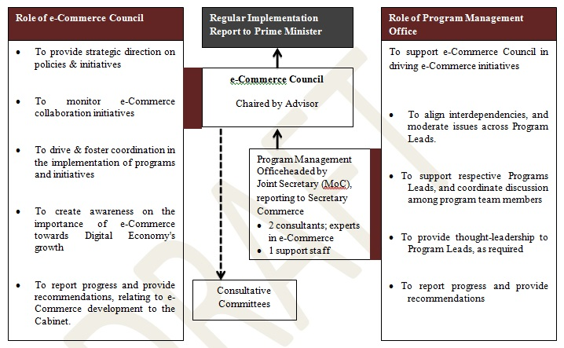
Implementation Arrangement

Slide 19
Action Matrix
S# | Policy Initiative | Key Areas | Lead Ministry/Dept | Facilitating Actors
1. | E-Commerce regulation and facilitation | Regulation & Facilitation | MoC, SECP, MoITT | FBR, Consumer Protection Councils, PPRA
2. | Financial inclusion and digitization through payment infrastructure development | Regulation, Facilitation, & Promotion | SBP | SBP
3. | Empowering Youth and SMEs through Business Support Programs and Trade Development | Promotion & Facilitation | MoITT / SMEDA / SBP | MoC, TDAP,SMEDA, Microfinance Banks MoITT
4. | Consumer Protection | Regulation & Facilitation | MoC ,Consumer Protection Councils, e-Commerce Platforms | Ministry of Law & Justice,
5. | Taxation | Promotion & Facilitation | FBR,PRAs | PRAs
6. | ICT Infrastructure and Telecom Services in Pakistan | Promotion & Facilitation | MoC, MoITT | USF, Ignite
7. | Logistics | Regulation & Facilitation | Pakpost, MoComm. | e-Commerce Platforms
8. | Data Protection and Investment | Regulation & Facilitation | MoITT, | MoC
9. | Global Connectivity and Participation in Multilateral Negotiations | Regulation, Facilitation, & Promotion | Pak Trade Missions, Associations & Chambers | MoC

Slide 20
Additions in the New draft
Foreword has been included for ownership of the document at the highest level.
Policy Framework’s goals have been aligned with the SDGs, for better implementation of the Policy Framework in line with Digital Pakistan Policy.
Only one definition of e-Commerce has been incorporated to any avoid ambiguity.

Slide 21
Additions in the New draft (proposals)
Establishment of e-Commerce Council ,to supervise implementation of the Policy Framework.
The companies having sales of more than one million PKR per annum, to be register with SECP. The purpose is to facilitate small businesses & startups.
The subject of e-Commerce, to be allocated to Commerce Division under the Rules of Business, 1973, for its better coordination and facilitation.
e-Procurement model, to be adopted by public and private sector,to encourage and promote digitization of procurement procedures in Pakistan.

Slide 22
Additions in the New draft
Gradual shift of Cash-on-Delivery (CoD) payment method to digital payments, with a time line of Sept, 2022 for payments beyond 10,000/= PKR. Furthermore, efforts shall be made to convert all CoD payments into digital payments preferably within 10 years (2029).
It is recommended that M/oIT&T in collaboration with SBP will approach PayPal and other payment gateways to ensure availability of several international payment gateways in Pakistan

Slide 23
Additions in the New draft
A dedicated chapter on Empowering Youth and SMEs through business support programs and recognition of free lancers as an important segment for enhancing exports has been further developed. Four special initiatives, as mentioned below, have been introduced in this regard
Creation of an e-Commerce business facilitation hub.
Empower youth and SMEs for e-Commerce, through Pak e-SME program.
Access to finance for SMEs to promote digitization in Pakistan.
Skill development Program.

Slide 24
Additions in the New draft
Establishment of e-Courts has been proposed
Data Protection, Localization and Sovereignty will be covered in Cloud Policy and Data protection Act being drafted by M/o IT&T
A new chapter on global connectivity and participation in multilateral negotiations has been added
A proposal has been incorporated regarding transformation of the Trade Development Authority of Pakistan into a digitally savvy and service oriented organization

Slide 25
Additions in the New draft
A dedicated chapter on ICT infrastructure and Telecom services in Pakistan has been included wherein it has been proposed that, Commerce and IT Ministries will continue expedited work on complementary policies such as accession to Information Technology Agreement of WTO.
In consultation with the M/o Communications it has been proposed that Ministry of Communications shall include a dedicated chapter on facilitating e-Commerce, including timely payments to sellers by the logistics companies, in its draft National Freight and Logistics Policy.

Slide 26
THANK YOU

